Slide 1
Vagal Indigestion
By
Hussein AlNaji

Slide 2
Vagal indigestion syndrome (vagus indigestion, Hoflund syndrome) comprises a group of motor disturbances that hinder passage of ingesta from the reticulorumen or abomasum or both.
The name vagus indigestion was introduced by Hoflund, he defined four types of functional disturbance, with obstruction of ingesta flow at two sites:

Slide 3
1. Omasal transport failure (anterior or proximal functional stenosis, reticuloomasal stenosis) impairs flow of ingesta through the reticuloomasal orifice and occurs with (a) atony of the reticulorumen (often associated with chronic recurrent bloat) or (b) normal to increased ruminal motility.
2. Pyloric outflow failure (posterior or distal functional stenosis, pyloric stenosis) impairs flow through the pylorus and occurs (a) continuously or (b) in an intermittent, recurrent pattern (incompletely)

Slide 4
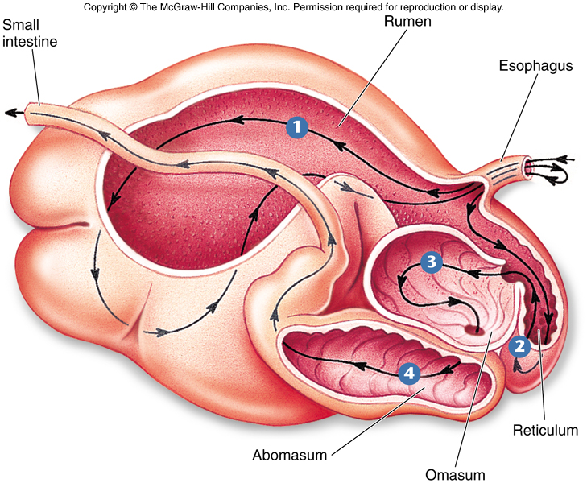

Slide 5
ETIOLOGY
The etiology of vagus indigestion has been controversial but has been divided into two major subcategories of complications of traumatic reticuloperitonitis: vagal nerve injury and reticular adhesions.
Other Causes
Fibropapillomas of the cardia.
Abomasal impaction in sheep.
Indigestion of late pregnancy of cows.
Peripheral nerve sheath tumors, such as a solitary schwannoma.
5. A vagal indigestion–like syndrome may be a postsurgical complication

Slide 6
FAILURE OF OMASAL TRANSPORT. Failure of omasal transport with hypermotility of the rumen is the most common naturally occurring form of the disease.
Accumulation of ingesta in the reticulorumen
Distention of the forestomachs, the omasum and abomasum remain relatively empty
characteristic signs: inappetence with gross distention of the rumen in the left flank.
Appetite diminishes as the rumen becomes overfilled

Slide 7
Characteristic abdominal contour often is called a “papple” shape because the left side of the abdomen is distended and assumes the appearance of an apple, whereas the right side assumes the contour of a pear.
The rumen assumes an L shape because the ventral sac occupies both the right and left ventral quadrants of the abdomen.
Affected animals often continue to drink water, but absorption from the rumen is poor, and the water accumulates in the forestomach while the animal becomes mildly dehydrated.
Reduced fecal volume due to decrease the passage of ingesta

Slide 8
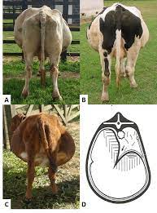
A, B, and C - Cattle with vagal indigestion showing bilateral abdominal distension and apple-pear abdominal contour. D - Schematic representation of the main finding found through rectal palpation in cattle with vagal indigestion. Source: Dirksen (1993)

Slide 9
Pyloric Outflow Failure. Failure of pyloric outflow (posterior or distal functional stenosis) causes accumulation of ingesta in the abomasum and omasum. Advanced stages of this form of the syndrome also display gross distention of the reticulorumen.
Overfilling of the forestomach as a result of reflux of ingesta from the abomasum (internal vomiting) may.
causing the chloride content of the ruminal fluid to increase and motility are reduced
Fecal production in these cases tends to be even less than with the anterior stenosis form of the syndrome
cause both marked dehydration and hypochloremic metabolic alkalosis.

Slide 10
Note:1 The most common predisposing cause of naturally occurring omasal transport failure (anterior or proximal functional stenosis) is TRP. Other causes of anterior functional stenosis include abscesses, adhesions, and local and diffuse peritonitis; hepatic abscesses; neoplasia of the ruminoreticular fold and esophageal groove; Foreign bodies that obstruct the reticuloomasal orifice.
Note2 : A common predisposing cause of pyloric outflow failure syndrome is volvulus of the abomasum. Other abomasal disturbances, including right and left displacements of the abomasum and abomasal ulceration, can cause the disease as well

Slide 11
CLINICAL FINDINGS
Inappetence for several days or complete anorexia with evidence of loss of BW.
An enlarged papple-shaped abdomen (pear-shaped on the right and apple shaped on the left) with or without bloat . The upper left abdomen is distended and the lower half of the abdomen is distended bilaterally.
Dehydration and electrolyte imbalance with metabolic alkalosis.
Enlarged rumen palpable on rectal examination.
Scant feces with an increase in undigested particles.
Enlarged ingesta-impacted or fluid distended abomasum palpable through right flank or on rectal examination Vital signs within the normal range. 9- Inadequate response to treatment.
Hypermotility or hypomotility of the rumen and reticulum determined by auscultation or ultrasonography, respectively

Slide 12
Clinical Pathology
Hemoconcentration,
Metabolic alkalosis with hypochloremia
Hypokalemia.
Increased ruminal chloride levels.

Slide 13
Differential diagnosis
Ruminal distension with hypermotility:
indigestion of late pregnancy.
obstruction of the reticuloomasal orifice.
b. Ruminal distension with atony: chronictraumatic reticuloperitonitis.
C. Abomasal impaction: abomasal impaction, dietary in origin.
D. Omasal impaction:
phytobezoars blocking the abomasal pylorus.
Abomasal ulceration without melena.

Slide 14
TREATMENT
The prognosis in most cases in unfavorable.
Rumen Lavage
Rumen can be emptied using a large-diameter (25-mm inside diameter) stomach tube followed by flushing warm water into the rumen and lavaging it by gravity flow.
2. Fluid and Electrolyte Therapy and Laxatives
Some cases respond beneficially following fluid and balanced electrolyte therapy for 3 days combined with the oral administration of mineral oil (5–10 L) daily for 3 days or dioctyl sodium sulfosuccinate.
3. Rumenotomy
Rumenotomy and emptying of the rumen is usually followed by slow recovery over a period of 7 to 10 days when there is ruminal hypermotility.

Slide 15
THANK YOU

